Slide 1

Graphics System
Graphics
Input Devices
Frame Buffer
And
Video Control
For Display
Computer
Memory
&
Storage
CRT
Hardcopy
Specialized Graphics
Processing Hardware
(Arithmetic logic unit,
….., etc.)
Graphics
Software

Slide 2
Common Raster Display System
Peripheral
Devices
CPU
System bus
Video
Controller
Frame
Buffer
System
Memory
Display

Slide 3
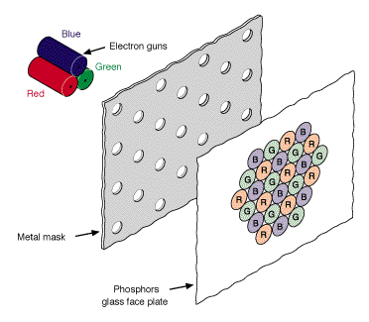
Color representation
Color generation on CRT screen
-- three primary color from each phosphor triad are “mixed” together

Slide 4
Raster Display
Raster display
- Raster system consists of:
display controller (input, refreshing, scan converting)
video controller
buffer memory (frame buffer)
CRT
- The buffer stores the primitive pixels, other than display list or display program
- Video controller can read the pixel contents to produce the actual image on the
screen
- The image is represented as a set of raster scan lines, and forms a matrix of pixels.
- need refresh the raster display (e.g., 60Hz)

Slide 5
Raster Display
Raster display
Host Computer
Display Processor
Keyboard
Mouse
Lucy
Video Controller
Lucy
Refresh buffer
Monitor

Slide 6
Raster Display
Raster scan with blanked retrace
Horizontal retrace
Vertical retrace
Scan line

Slide 7
Video Controller
Access the frame buffer to refresh the screen
Control the operation for display
Color look-up table
Linear
address
X
address
Frame
buffer
Raster-scan
generator
Horizontal
& vertical
Deflection signal
Y
address
Data
Pixel
values
Intensity
or color

Slide 8
Video Controller
Types of refresh
Interlaced (most for TV for reducing flickering effect, NTSC, PAL, SECAM)
- two fields for one frame
- odd-field: odd-numbered scan lines
- even-field: even-numbered scan lines
- refresh rate: e.g., NTSC: 60Hz (60 fields per second); 30 frame/s.
PAL: 50Hz
Non-interlaced (most for monitor)
- refresh rate: e.g., 60Hz or more
Odd-field
Even-field

Slide 9
Video Controller
Output of video controller:
- RGB (red, green, blue, synchronization) (best quality)
- Composite video (e.g., composite color and synchronization)
- Monochrome (e.g., intensity plus synchronization)
- NTSC (525 scan lines, 60Hz))
- PAL (625 scan lines, 50Hz)

Slide 10
Raster Display
Raster display
Refresh rate is independent of complexity of the display contents
Easy to area filling
Line or polygon must be scan-converted into the component pixels in the frame buffer, which is computationally expressive.
Less accurate: lines are approximated with pixels on the raster grid.
This visual effect (I.e., jaggies or stair-casing) due to a sampling error is called “aliasing”

Slide 11
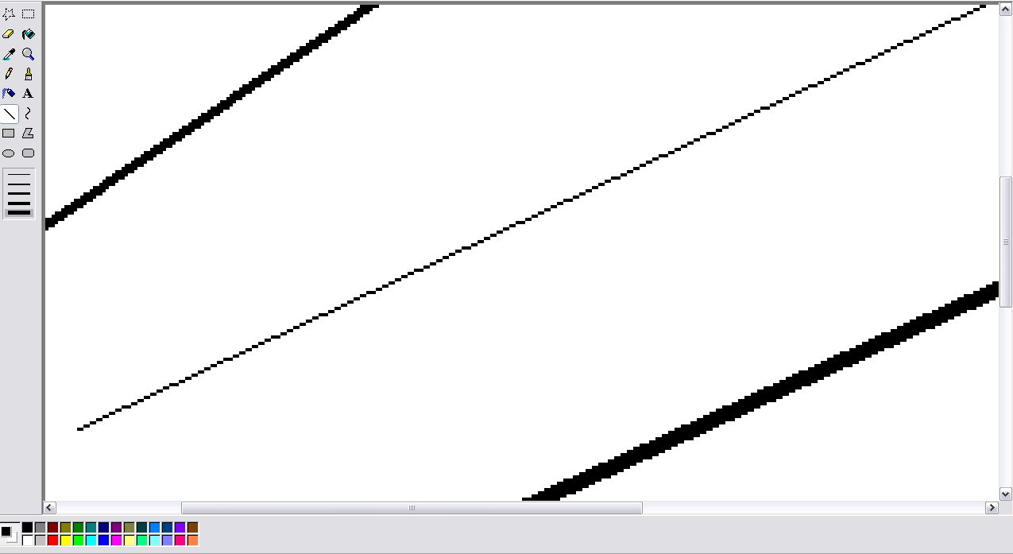
Aliasing

Slide 12
Color Look-up Table (LUT)
LUT
LUT has as many entries as there are pixel values, the values in the bit planes are used as indices into one or more LUT.
A pixel value is used not to control the beam directly, but rather as an index into the look-up table.
The table entry’s value is used to control the intensity or color of the CRT.
for example:
8 bits pixels in the frame buffer require a LUT with 256 entries.
Pixel value 67 → access the content in the entry 67 of the table → use this
content to control the CRT beam
The total number of bits in each entry is called width of the LUT,
which is the capability for providing all possible colors
The look-up operation is done for each pixel on each display cycle, fast access of the table is required.
LUT can be loaded on program command.

Slide 13
Color Look-up Table
LUT
The number of the bit planes → determines the number of colors displayable on the screen simultaneously
The width of LUT determines the number of possible colors that we can choose from
Example:
R (n bit planes) → R_LUT with 2^n entries
G (n bit planes) → G_LUT with 2^n entries
B (n bit planes) → B_LUT with 2^n entries
If each LUT has w width, then there are 2^(3n) colors displayable, chosen from a total of
2^(3w) possible colors.
Color Look-up-tables are called palette registers.
Palette
- Each set of 2^(3n) colors is called a palette
- Foreground window sets up color LUT → called system palette

Slide 14
Using LUT under Windows
Part of System palette (system color LUT) can be modified by logical palette
(e.g., in 8bits system, 20 out of 256 colors are static, remaining are allowed to change)
→Setup logical palette structure
→Create Palette() -> hPal
→Select Palette() into device context (hDC, hPal, ..)
→Realize Palette(hDC) (mapping the logical palette to the system palette)
→Using Palette (e.g., setpixel(hDC, x, y, PALETTEINDEX(i))
→Finish using the palette (restore the old palette: Select Palette(hDC, hPalOld, ..))
→Delete the obsolete palette: DeleteObject(hPal))
typedef struct tagLOGPALETTE
{ WORD palVersion; // window version 3.0 or later
WORD palNumEntries; // the number of colors to be changed in the palette
PALETTEENTRY palPalEntry[ ]; // describe each new entry in the palette (color LUT)
}LOGPALETTE;
typedef struct tagPALETTEENTRY
{
BYTE peRed; //define three intensities of red, green, blue
BYTE peGreen;
BYTE peBlue;
BYTE peFlags; // describe how the mapping (from logic palette to system palette) is to be done for that entry
} PALETTEENTRY;

Slide 15
Software for Graphics
Lowest Level (earliest):
-- Assembly/machine language
-- program drive hardware directly, non-portable, difficult to program,
fast.
Medium Level (General Programming Package):
-- A. Extensions to high level languages → graphics libraries
(e.g., Window’s GDI, Silicon Graphics GL, etc.)
Easy to program, More portable, but still platform dependent
slower.
-- B. Standard Graphics Packages (set of specifications)
(e.g., GKS, PHIGS, OpenGL, etc)
platform independent, with binding for many high level languages
→ syntax for accessing graphics functions
Special-purpose application packages:
-- very specific use (e.g., 3D studio, Corel Draw, etc.)

Slide 16
Software for Graphics (cont’d)
Platform dependent:
e.g., Silicon graphics GL (graphics library), Microsoft DirectX,
They can be used in high-level programming language, such as
C, C++….
Generate the most commonly used picture primitives (components)
such as lines, circles, polygons, setting colors, intensities, set
view port and transformation…
Platform independent:
e.g., Standard graphics packages:
OpenGL, GKS(Graphics kernel system), PHIGS (programmer’s
hierarchical interactive graphics standard) (language independent)
Strong functionality and more complete and flexible to use.
Application packages:
Special-purpose, e.g., 3D studio, etc.
lowest machine level (not commonly used in modern graphics)

Slide 17
Software Framework for Interactive Graphics
Three components:
Application model (AM)
-- represents the data or objects to be pictured on the screen
Application program (AP)
-- creates, stores into, and retrieves from the application model; Traverse the model to extract the information for display; build, modify and maintain the model.
Graphics system (GS)
-- a series of graphics output commands that contain both a detailed geometric description of what is to be viewed and the attributes describing how the objects should appear; handling user input
AM
AP
GS
Monitor
Keyboard, mouse, …

Slide 18
Coordinate System Transfer
Purpose:
Convert the display from the physical object in the world to the object displayed in the screen
Modeling coordinate system (MC)
-- local coordinate system (2D or 3D)
-- define the coordinates for each object individually
-- scale and unit are varied from object to object
World coordinate system (WC)
-- global coordinate system (2D or 3D)
-- can place all defined objects together in a scene within this reference
system
-- MC → WC (modeling transformation)

Slide 19
Coordinate System Transfer
Device coordinate system (DC)
-- display coordinate system on the output device (e.g, screen)
-- 2D only
-- platform dependent
-- WC → DC (viewing transformation)
Normalized device coordinate system (NDC)
-- make DC independent to the hardware
-- normalize the x and y into the range of [0, 1]
-- stage between WC and DC
Coordinate system transfer pipeline
MC(x,y,z) → WC(x,y,z) → NDC(x,y) → DC(x,y)
Device independent transformation

Slide 20
Window to Viewport Transformation
Window
-- Expressed in world coordinate system
-- 2D or 3D
-- The range of interest of the scene is defined as:
[wMin_X, wMax_X, wMin_Y, wMax_Y, wMin_Z, wMax_Z]
Viewport
-- Expressed in device coordinate system
-- 2D only
-- The range of interest of the scene is defined as:
[vMin_X, vMax_X, vMin_Y, vMax_Y]
Window to viewport transformation
Mapping from a window to a viewport

Slide 21
Window to Viewport Transformation
Clipping
-- With respect to a window or a viewport, the parts of the scene outside
the defined range of interest will not be displayed, so they must be
removed
Applications
-- Effect of Zoom-In:
Window size is reduced gradually frame by frame, and clipping and
mapping to the viewport
-- Effect of Zoom-out:
Window size is increased gradually frame by frame, and clipping and
mapping to the viewport
-- Effect of Panning
Window is translated from frame to frame, and clipping and
mapping to the viewport

Slide 22
Graphics software standards
Reason for standardization: portability
Hardware independent
Programming language independent (provide language binding capability)
e.g., OpenGL
OpenGL
- Powerful and complete functions
- easy to use, most popular
- portable

Slide 23
Functions in Graphics software standards
Functions for output
-- generating output primitives (e.g., points, lines, curve lines, polygons, circles, filled areas, shape, …
Functions for Setting Attributes
- intensity, color, line styles, text styles, area filling patterns
Functions for viewing
- geometric transformation (e.g., affine transformation)
- model transformation
- view transformation
Functions for objects (or segmentations, structures)
- dividing a scene into component parts for manipulation
- e.g., display list in OpenGL is used to group OpenGL commands
which have been stored for later execution

Slide 24
Functions in Graphics software standards
Functions for input
-- user manipulates graphics object interactively
-- e.g., graphic library utility tools provide input-handling functions, such
as mouse events handling
Functions for control/housekeeping
- window and graphics system initialization
- e.g., creating window, main loop, initialization window, display mode, ….
Functions for image operation
- access image bitmap
- e.g., read, draw, copy, write pixels.
Functions for rendering
- increase photo-realism
- e.g., lighting, shading, hidden surface removal, reflection, materials,
anti-aliasing, depth buffer, double-buffer for animation

